Slide 1
BOB JONES HOSA
BOB JONES HOSA
creating future health professionals

Slide 2
WHAT IS HOSA?
HOSA is an international organization for students interested in becoming a healthcare professional or the healthcare field.

Slide 3
History
HOSA - Future Health Professionals started when a group of health education representatives from only six states decided to create an organization focused on leadership, healthcare education, and career preparation. HOSA was officially established in 1976 and quickly became a success due to the motivation, inspiration, and leadership it brings to students. Since then, HOSA has spread across the United States and has even reached other countries, like China and Puerto Rico.
The Bob Jones HOSA chapter was created in 2009 for students passionate about healthcare and the well-being of others. Our HOSA chapter strives to serve our community and peers through community service, such as Special Olympics and classroom hygiene, and educational events, such as inviting guest speakers speakers and our annual leadership conferences.

Slide 4
HOSA has over 245,000 members, with chapters all over the world, including Puerto Rico, Ireland, and China.

Slide 5
GOALS OF HOSA
Develop future leaders of the health industry
Offer insight into different health careers within the health field
Provide scholarship, community service, and outreach opportunities

Slide 6
Develop future leaders of the health industry
HOSA provides many opportunities to take initiative. Whether it’s volunteering to help out in the blood drive, writing thank-you notes to health professionals, or organizing to wash desks after school, HOSA members are leading it. Our community projects are there to inspire you to be the best leader you can be.

Slide 7
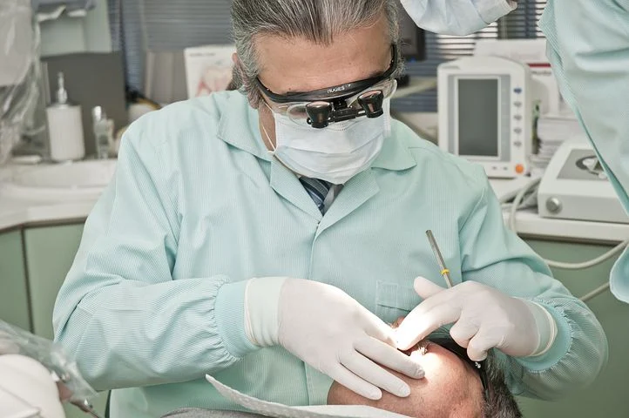
Offer insight into different health careers within the health field
Whatever medical professional you want to be, HOSA can give you lots of great opportunities to help you achieve your dreams! You get to hear amazing speakers, make connections with people in healthcare, and follow your passion.
“
“

Slide 8
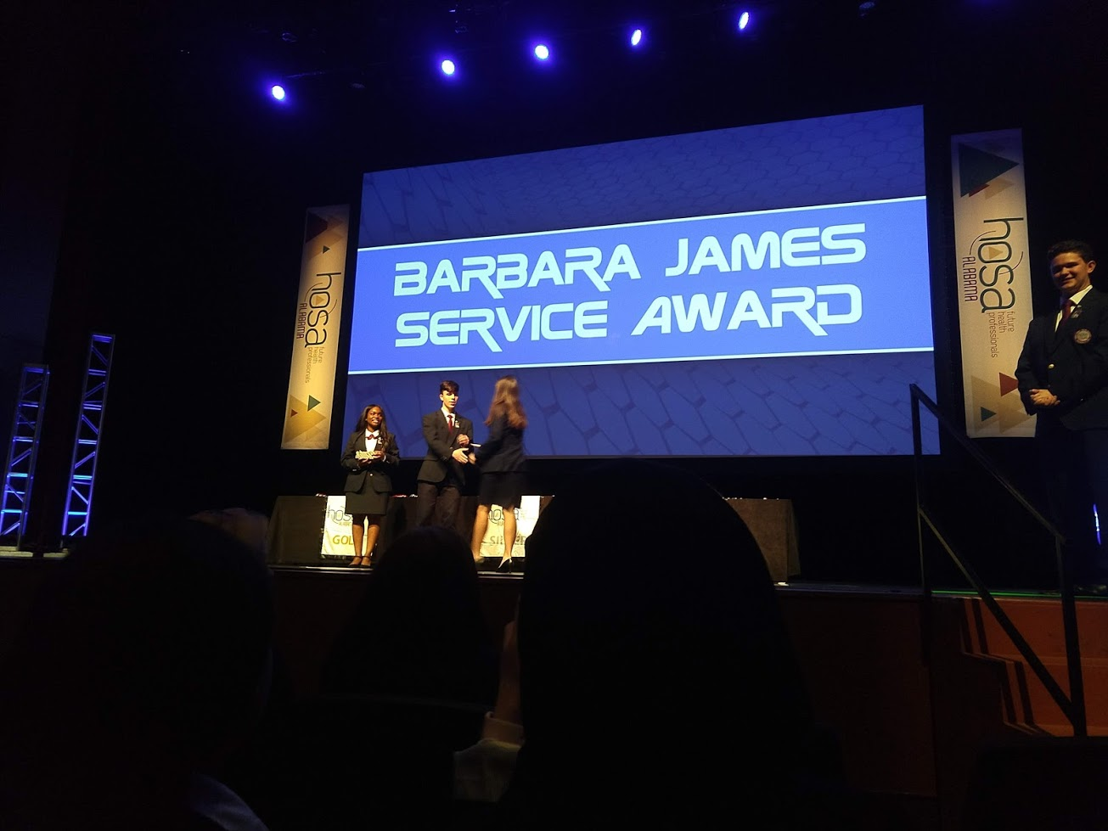
Provide scholarship, community service, and outreach opportunities
Along with all of the amazing people you will meet, there are tons of amazing opportunities to get scholarships, help out the community, and even meet more amazing people!
Every year, HOSA awards scholarships to select seniors around the country. You could be one of them!
Every year, out HOSA chapter sets up a blood drive. This is an amazing opportunity to help out those that need it!
Speakers come from all around Madison and Huntsville to share their experiences with Bob Jones HOSA. This is a great way to make connections!

Slide 9
HOSA CORE VALUES
learning
leadership
service
innovation

Slide 10
Learning
Competitive events are designed to motivate students and offers recognition to those who are determined and prepared.
Event Categories-
Health science, health professions, emergency preparedness, leadership, teamwork, and recognition
Being involved in HOSA isn't just about being part of an amazing community. It's also about expanding your knowledge of the world through medicine. Much of the information that you learn applies in school and daily life, and even creates a great foundation for a professional workplace.
We respect and seek to learn from the experience of teachers, peers, and patients.

Slide 11
Leadership
All HOSA members can build on their foundation of leadership knowledge through community service and other opportunities.
Everyone makes up an important part of the team; in many cases it's up to you to take initiative, so leadership qualities will be developed. One such leadership opportunity is becoming an officer. Officers lead the HOSA chapter after being elected.
In HOSA, we serve as role models in our community, academic program, and later, our profession. We strive to become ethical, accountable, and trustworthy. We use our influence to empower others to achieve excellence.

Slide 12
Service
In our local HOSA chapter, you can serve the community in many ways. From organizing blood drives, informing our school about COVID-19 safety guidelines, and to simply washing desks, you can greatly improve not only our community, but yourself as well. Every individual is important, and we will treat everyone with respect and care.
2 hours for the Fall semester
Sending thank-you/encouragement letters to doctors, nurses, first- responders, etc.
Making/donating masks
“Be the Match” blood marrow donation
Creating online infographics/posters about COVID-19

Slide 13
Innovation
As a member of HOSA and competitive healthcare events, you will learn and be able to expand on creativity and problem solving skills.
Q: How is HOSA going to expand my creativity and problem solving skills?
A: During your study for competitive events, you will gain knowledge of your field of interest. You can then apply that knowledge to create new medical technology, devices, medical apps, etc. that can influence global health care.
Q: Why are those skills important? How will it help me and other people?
A: These skills allow you to improve your study habits and organization skills for a brighter future, allowing you to design medical innovations that can enrich the lives of others.

Slide 14
STATE LEADERSHIP CONFERENCE
Competition
Service Awards
Networking
Learn, compete, and meet new people in Montgomery!
HOSA will honor and recognize the students who involve themselves in their communities.
At Montgomery, you will have a chance to meet fellow members and competitors, both from Bob Jones and other schools from across Alabama.

Slide 15
About SLC
If you qualified to go to SLC by doing well on the State Qualifying Event (SQE, which is held at school, online), you will go to Montgomery in the early spring!
At SLC, there are very many events planned: guest speakers, meet and greet with colleges, hanging out with your friends in the hotel, and of course, the competitions!
During SLC, you have much free time to cheer on your friends and network with HOSA members from other chapters!
At the end, there is a closing ceremony to honor the winners, and to congratulate all of the participants and advisors!

Slide 16
Competition
After qualifying by doing well on SQE, you can choose to go to SLC
You will compete with students from all over Alabama high schools
Certain events are team-based, skill-based, or knowledge-based, but they do not differ in format from the SQE.
During the closing ceremony, the top 6 in each event will be announced, and the top 3 qualify for ILC.

Slide 17
Service Awards
Barbara James Service Award
President’s Volunteer Service Award
Anyone who completes 50 or 100 or more hours of community service (depending on their age) can also earn the President's Volunteer Service Award.
The President's Volunteer Service Challenge is a White House initiative which recognizes young Americans with awards and scholarships for outstanding community service, while encouraging more young people to serve.
This award is an extension of the Barbara James Award.
Purpose: To encourage HOSA members to become contributing members of their communities by performing worthy volunteer community service hours related to health.
Levels of recognition:
• Bronze Level: 100.0 – 174.9 hours
• Silver Level: 175.0 – 249.9 hours
• Gold Level: 250.0+ hours
At SLC, your name will be separately called out and you will get a chance to go to ILC!
Gold (250.0+)
Silver (175-249.9)
Bronze (100-174.9)

Slide 18
Barbara James Award
Do my service hours count?
Not all volunteer hours provide community service. Only community service hours that are performed for the common good, AND related to health should be approved for this event.
What service opportunities will help the HOSA member be the best health professional in the future?
• Does the activity provide a service to the community?
• Does this activity meet a need in your community?
• Does the activity relate to health?
• Is the activity related to the health science curriculum?
Examples of Approved Community Service:
• Volunteer at a senior center or hospice or as a hospital/health facility volunteer
• HOSA activities that serve the community - in the community (flu clinic, blood drive, community health fair)
• Fundraising for charity or the community (American Red Cross, March of Dimes, American Cancer Society)
• Church activities that serve the community at-large and are health related
• Rescue squad volunteer

Slide 19
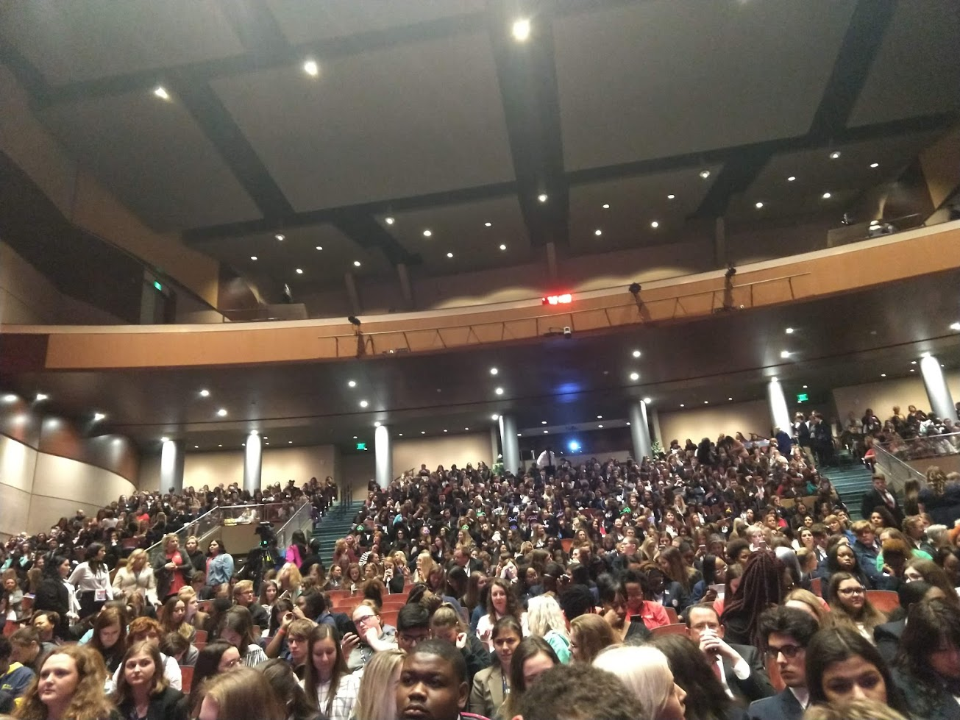
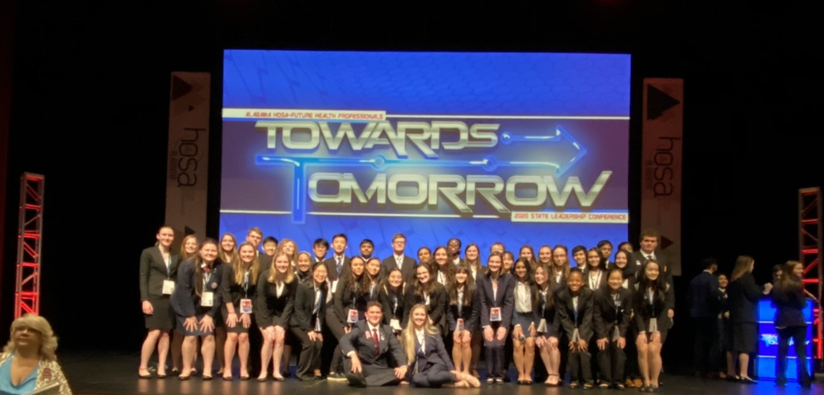
Networking
Students from all over Alabama come together in SLC; these people share common interests with you, namely medicine!
During your free time (between events, in the evening, or even in the hotel), you can meet with your fellow future health professionals to improve your knowledge of HOSA, medicine, or just to make new friends!
After the majority of the competitions, there is a college fair, where colleges from around the state, and sometimes out of state, welcome you and give you goodies and information about them!
Commonly, companies like Scantron or those who supply first responders also are present, so you can meet some of the people with who you will work with in the future.

Slide 20
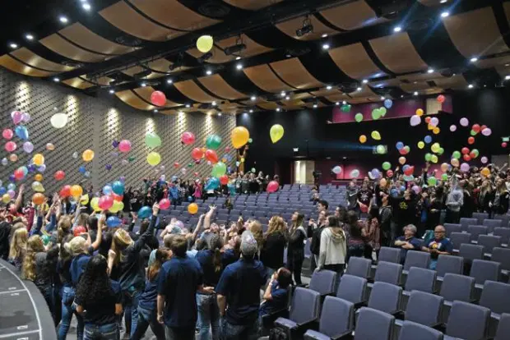
Having fun!
One of the most important parts of HOSA is to have fun, which you can easily do at SLC!
Be it in the hotel room having pillow fights, going out with friends to dinner, or even studying before with a group, SLC offers a wide variety of amusement!

Slide 21
INTERNATIONAL LEADERSHIP CONFERENCE
Service Awards
Competition
Networking
ILC also has Service Awards. These honors are given to students who have reached the ILC’s required number of service hours.
If you place in the top 3 of your competition, you are eligible to attend ILC, where you will be able to compete against students from all over the world!
ILC welcomes attendees from all over the globe, giving students the chance to meet people from many different experiences!

Slide 22
2021 ILC: Orlando, FL

Slide 23
General Information
Fees
Meetings
Volunteer Hours
40$ per student
The first Wednesday of each month
2 hours required this fall semester

Slide 24
Meetings
The first Wednesday of each month in room N210
Until it is safe to meet in person, we will meet online through Google Meet. for students who chose to attend school virtually later in the school year, we will provide an online option for them to attend meetings.
Our First Meeting is: August 19th

Slide 25
Fees
$40 for both new and returning members
HOSA is an international organization, requiring local chapters to enroll members in both the state and international registry. There is a 5$ increase from past years. Dues are also used to fund bus trips and any projects our chapter might take on. If you have any questions or concerns about fees, please do not hesitate to ask Mrs. Lawson!
Fees are Due no later than September 30th!

Slide 26
Service Hours
Members will be required to complete 2 service hours for the fall semester
During these uncertain times, we find it more suitable to take a look at things semester by semester. This is no different for service hours. Many of the in person service opportunities have been placed on hold until further notice, but we still intend to provide service projects for both virtual and in-school students to participate in to meet our requirement.
Service Hours will be checked at the end of the semester!

Slide 27
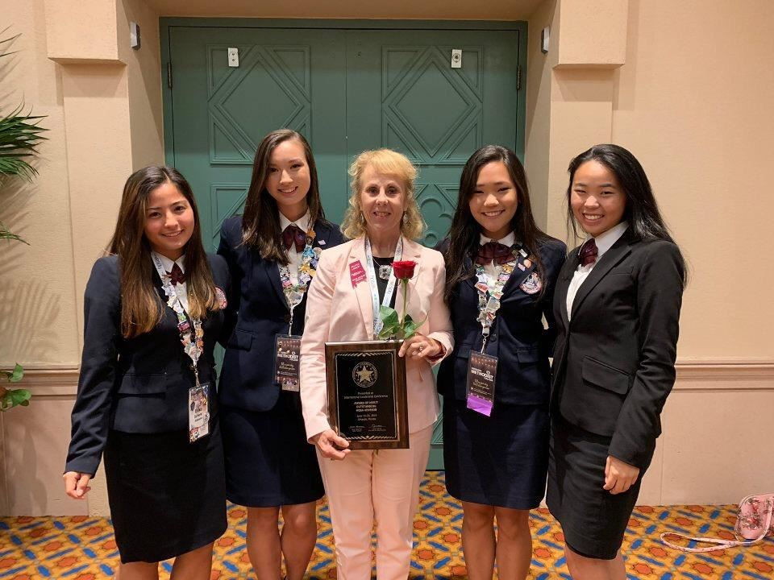
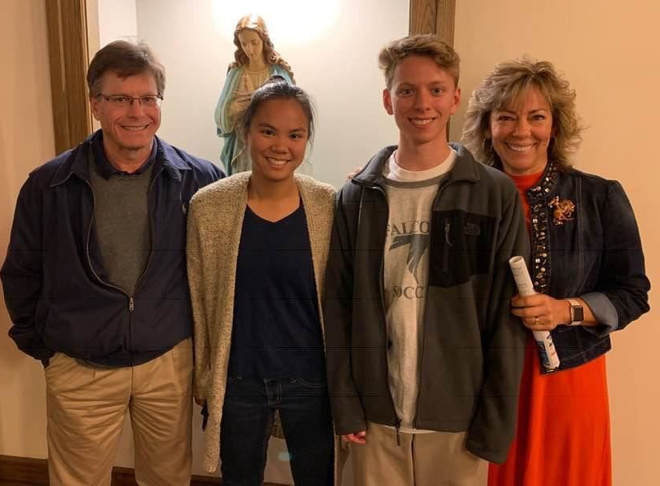
ADVISORS
Mrs. Lawson
Mrs. Teare
Advisor
Advisor
Mrs. Lawson teaches PBS, BI, HBSF and FHS and has been a
RN since 1980. She taught at UAH 17 years before coming to BJHS in 2009. Her husband is a NP and she has two daughters and one grandson.
Mrs. Teare teaches PBS, HBS, MI, HBSF, and FHS. She is a NP with cardiac subspecialty and has been teaching at Bob Jones since 2012. She has two children.

Slide 28
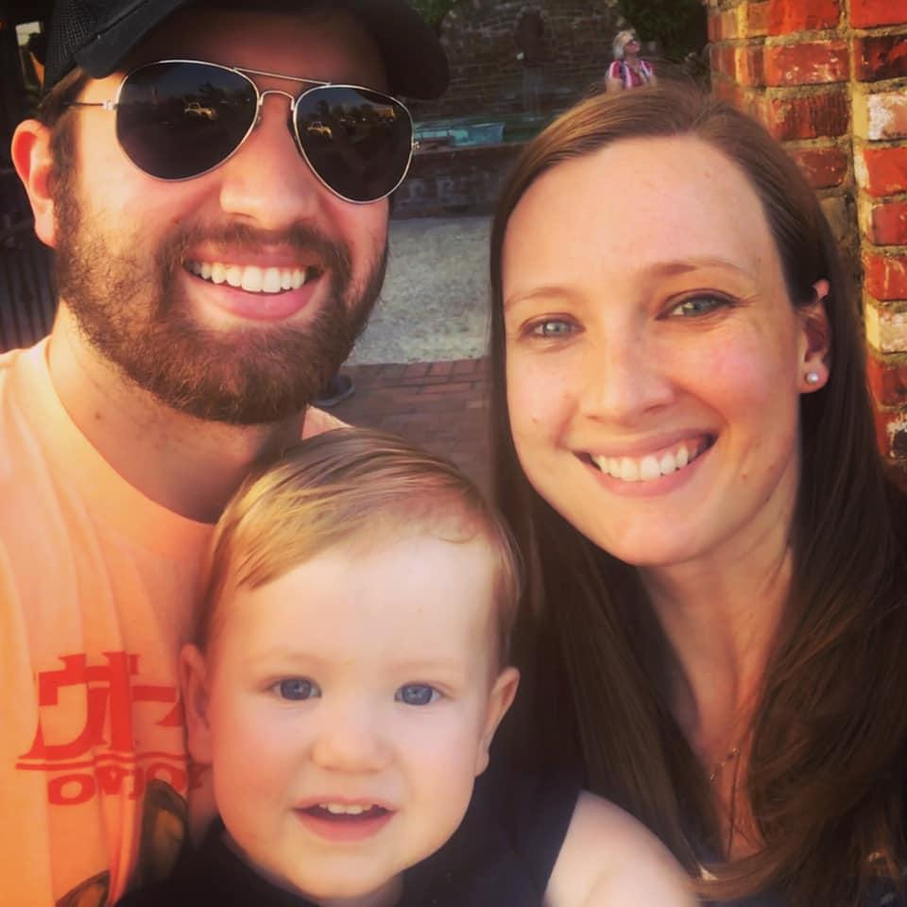
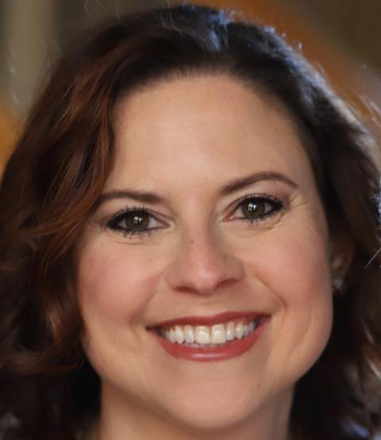
ADVISORS
Mrs. Dennis
Mrs. Koler
Advisor
Advisor
Teaches: FHS, HBSF, and Intro to Pharmacy. She was Mrs. Lawson’s nursing student when she taught at UAH. She has been a RN for 17 years and has been teaching at Bob Jones since 2018.
She has five sons.
Mrs. Dennis teaches FHS and HS Internship. She has one son.

Slide 29
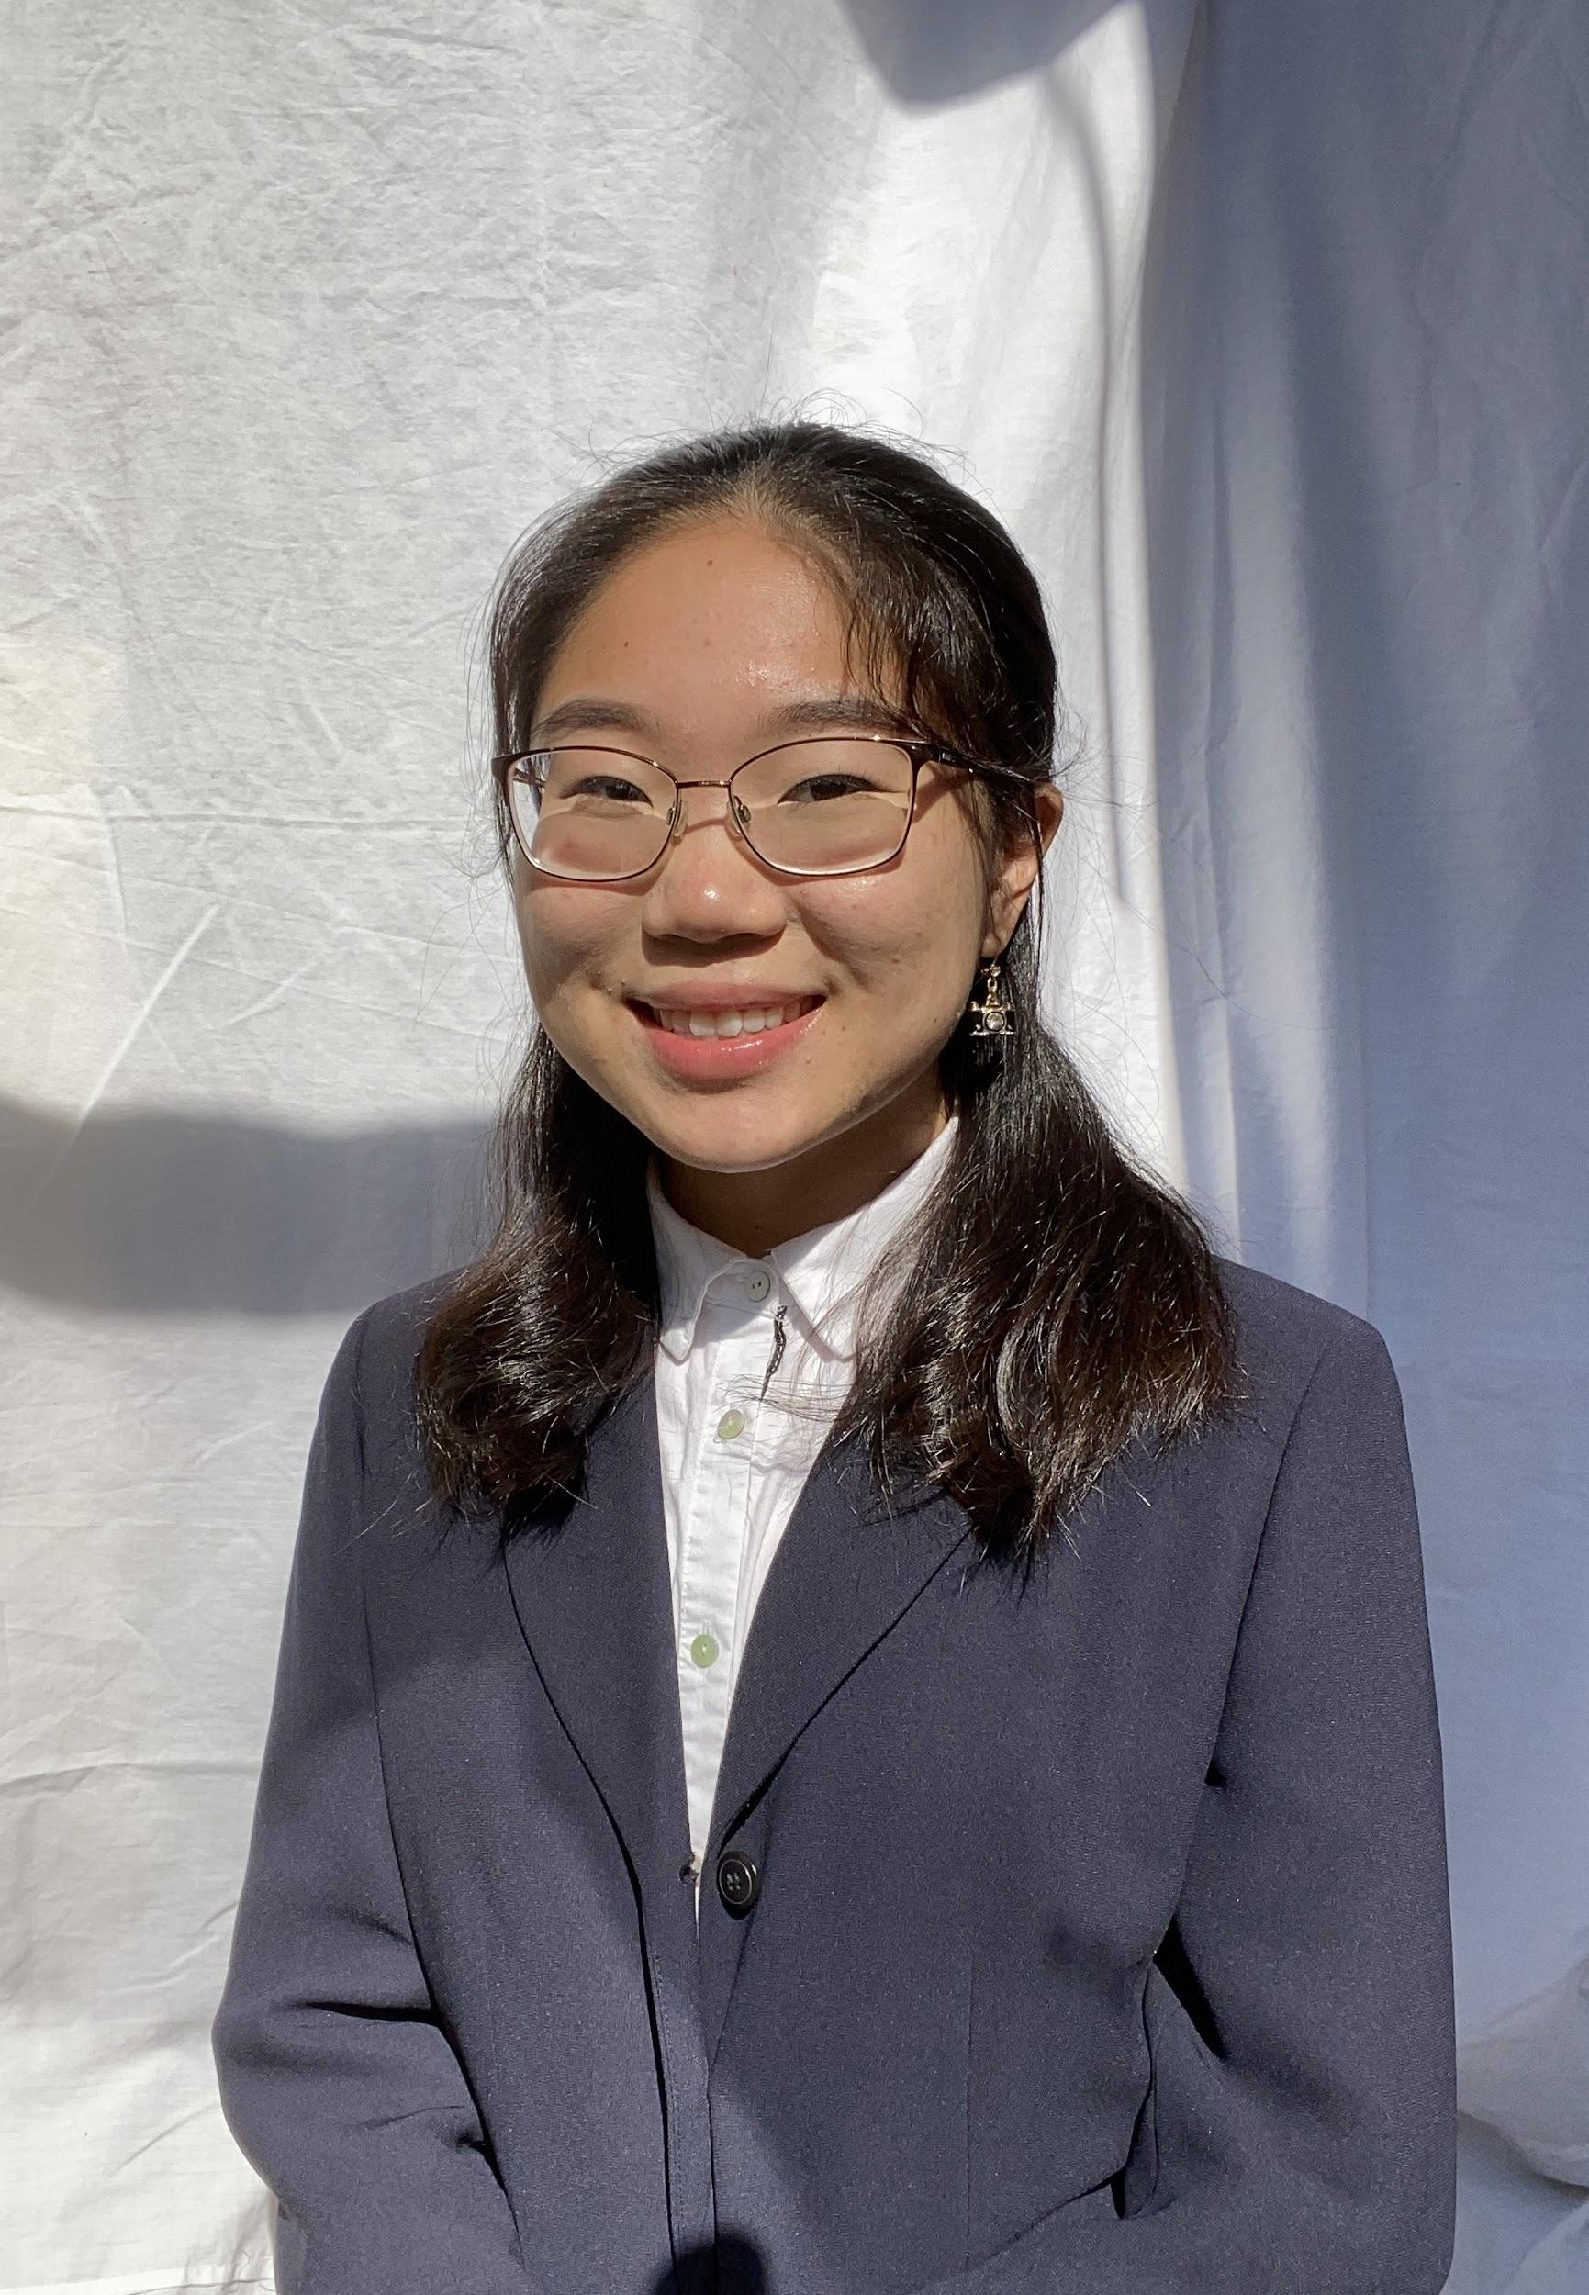
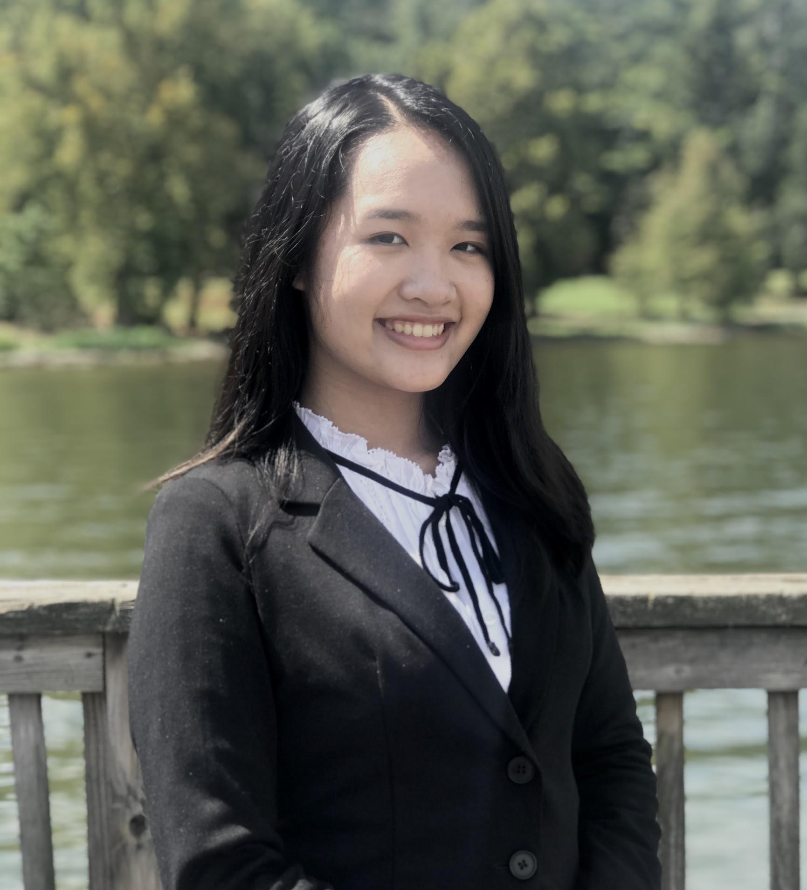
OFFICERS
Susan Xiao
Nini Nguyen
President
VP of Fundraising
Senior
Competitive Event: extemporaneous health poster
Career Goal: undecided
Why I Joined HOSA: I wanted a better understanding of healthcare. I also really enjoy science, and found that HOSA has wonderful opportunities for it !
Junior
Competitive Event: Pharmacy Science
Career Goal: Pharmacist, Pediatric Oncologist
Why I Joined HOSA: I joined HOSA to be a part of a family
and team with one goal: to be the next generation of
healthcare professionals who work together towards a
more positive and efficient future :)

Slide 30
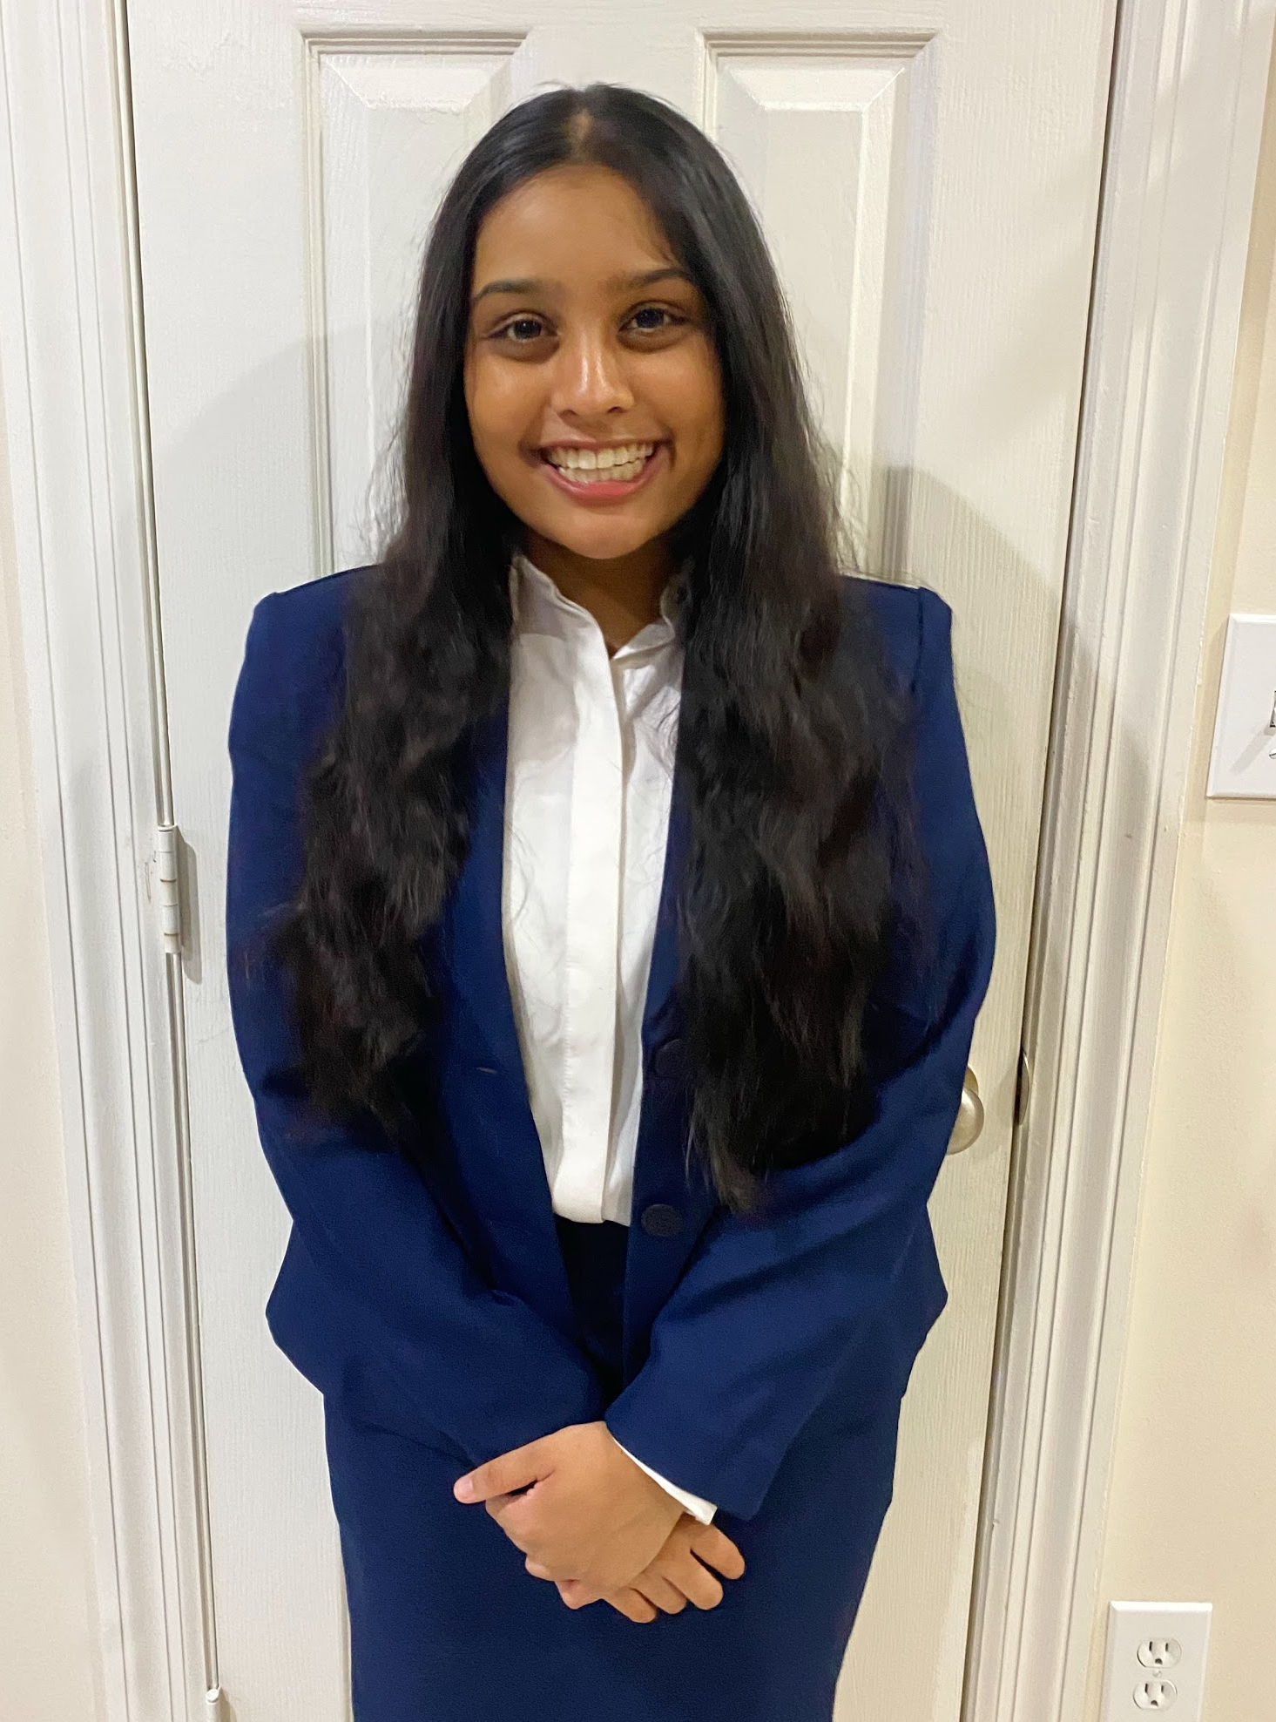
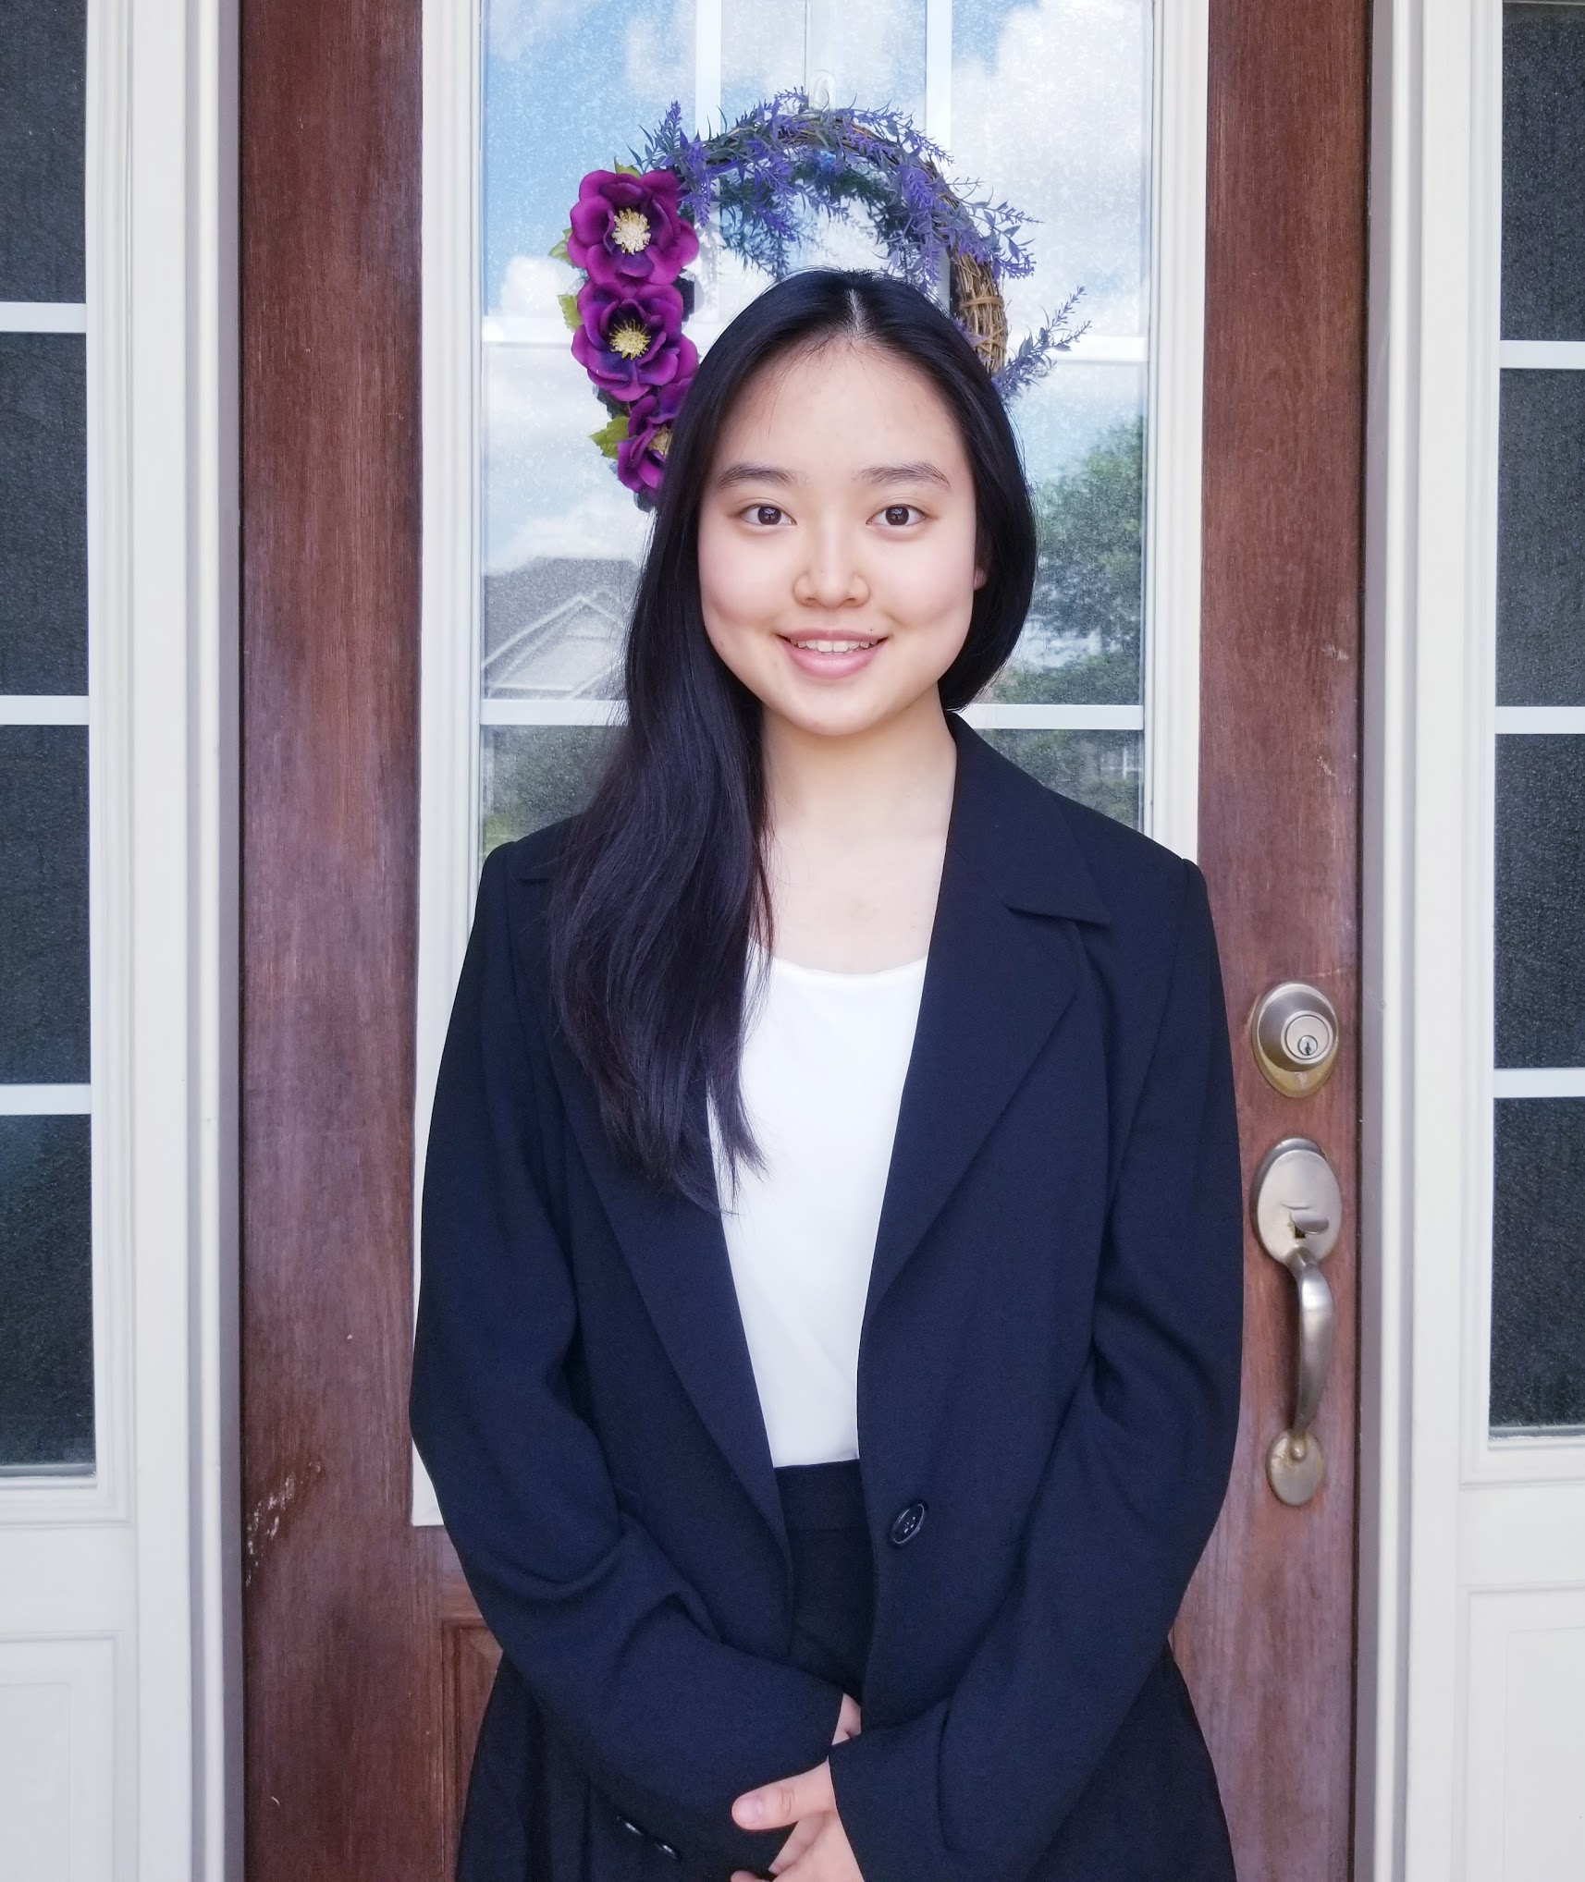
OFFICERS
Maanasi Limaye
Emily Lee
VP of Volunteering
Secretary
Junior
Competitive Event: Forensic Science
Career Goal: Surgeon or Biomedical Researcher
Why I Joined HOSA: I joined HOSA to be a part of a community that share the same interests as me and to explore various professions in healthcare.
Sophomore
Competitive Event: Medical Terminology
Career Goal: Pediatrician, Immunologist
Why I Joined HOSA: I joined HOSA to explore various careers in healthcare and to be part of the healthcare workers of tomorrow.

Slide 31
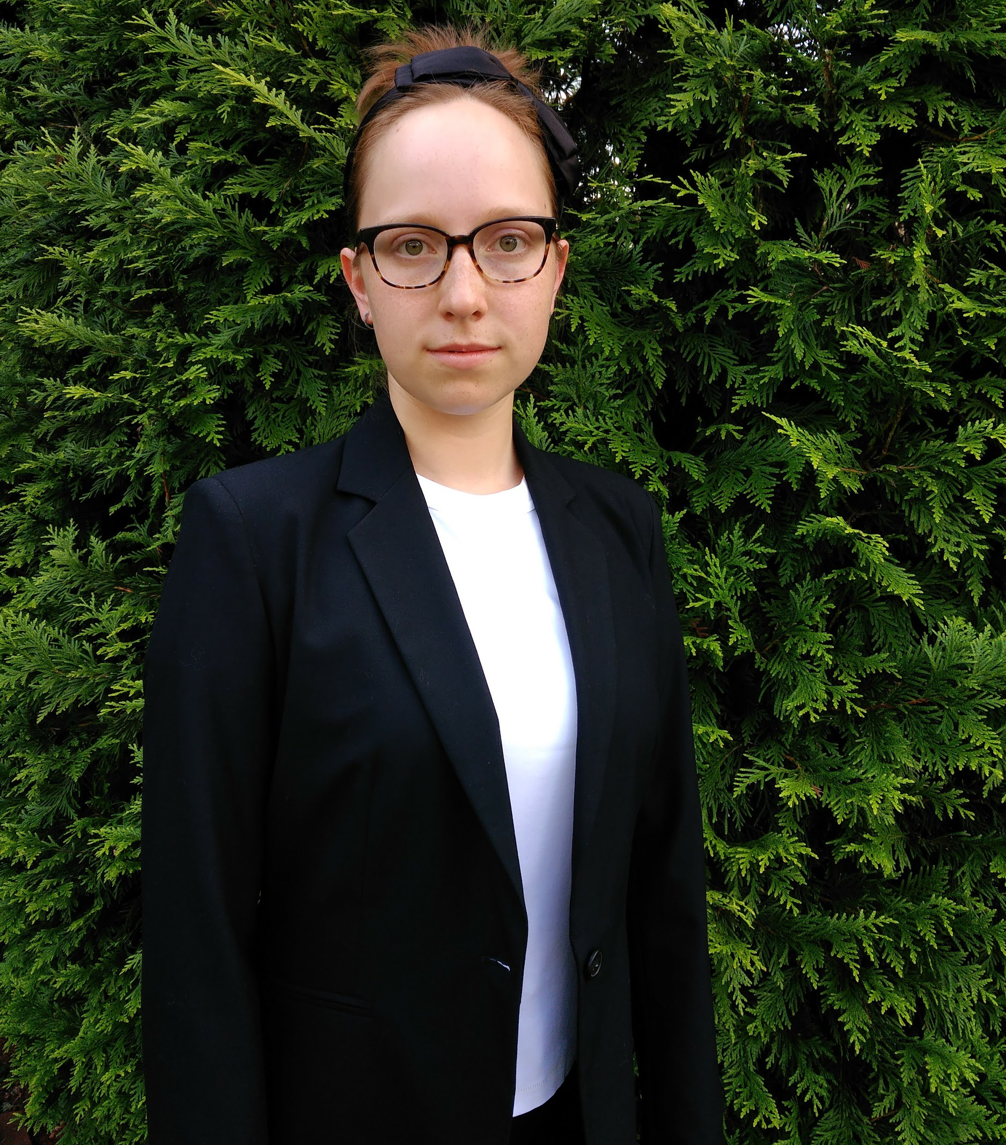
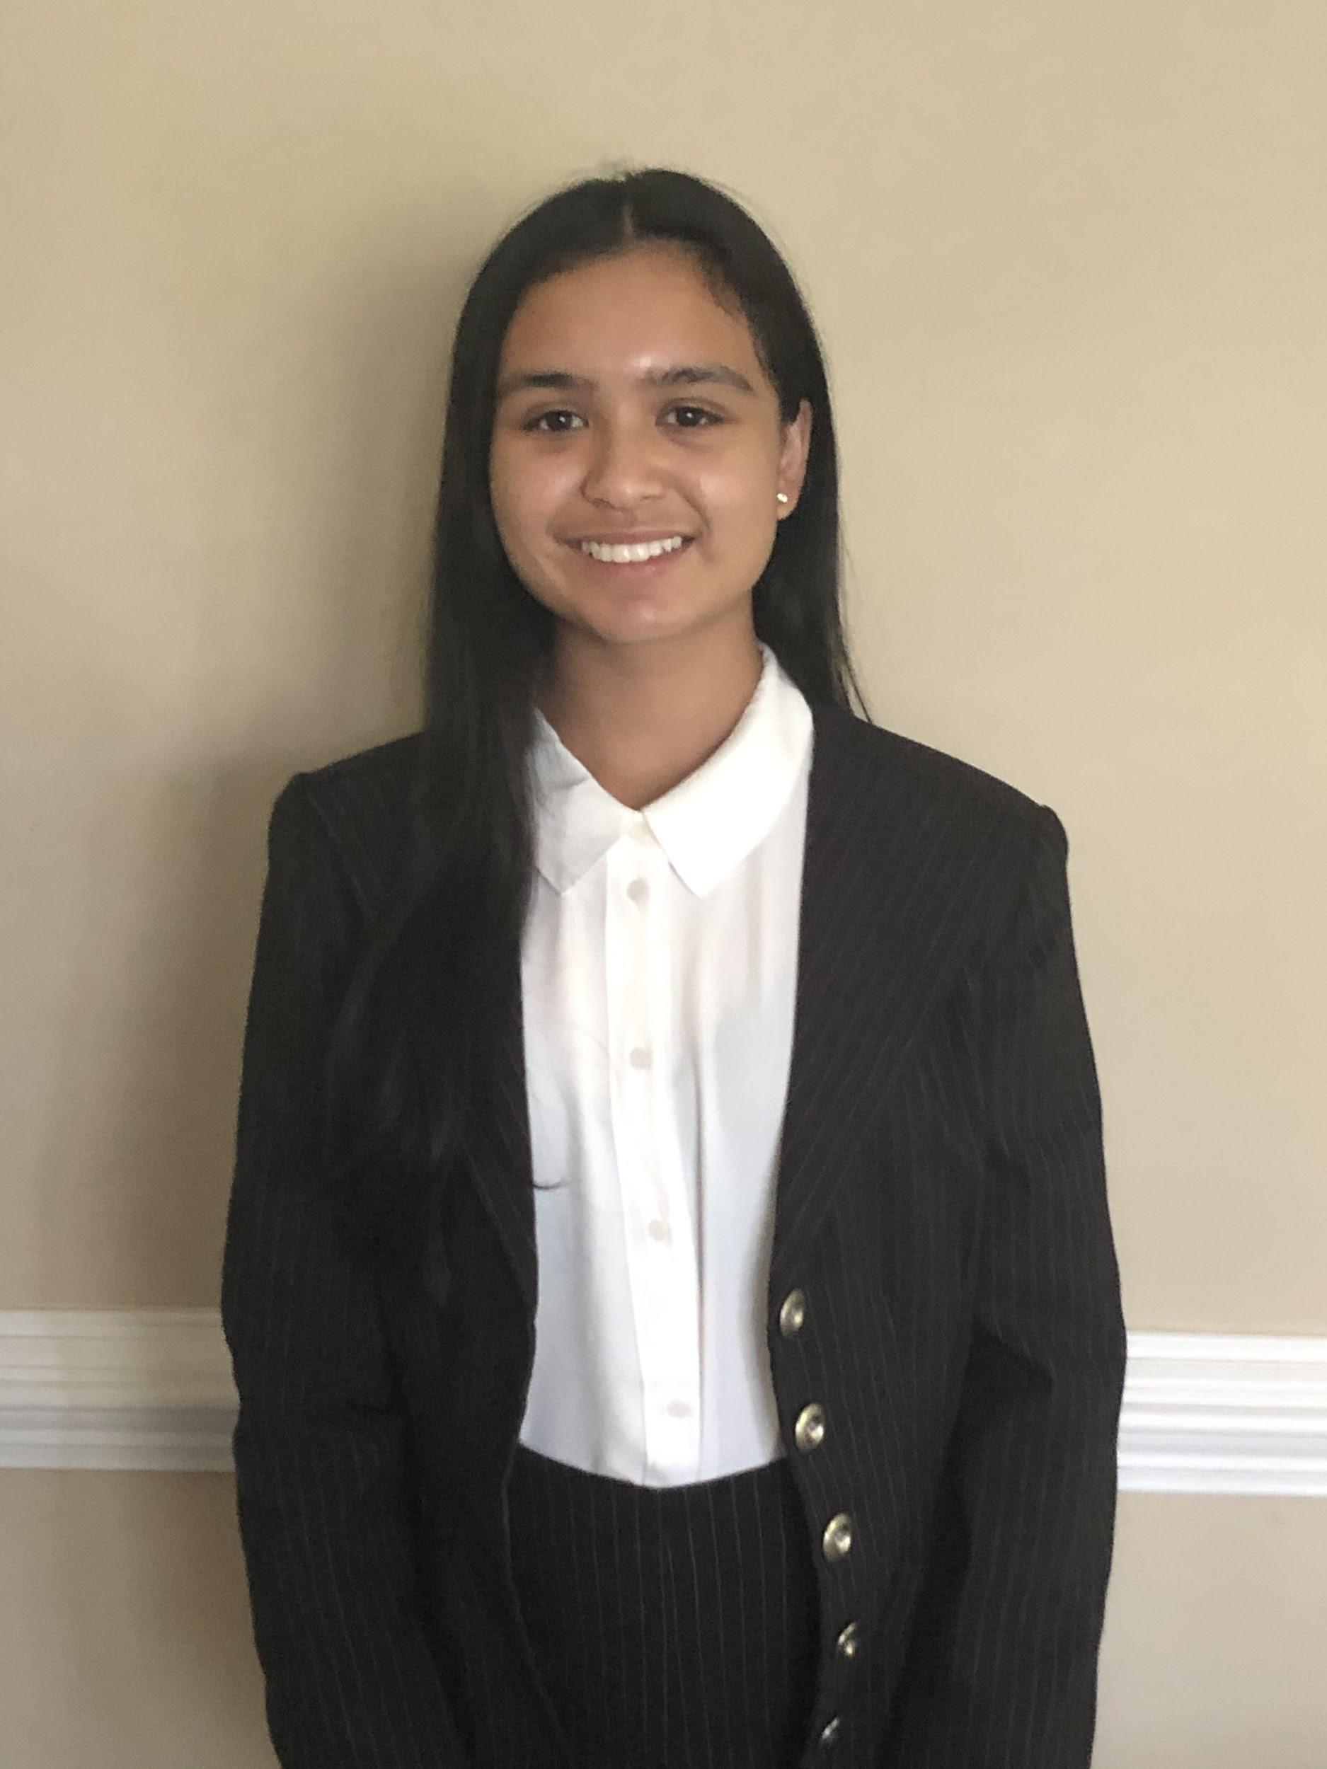
OFFICERS
Thais Arslanbekov
Hannah Evans
Treasurer
Historian
Sophomore
Competitive Event: Behavioral Health
Career Goal: Rheumatologist, Neurobiologist
Why I Joined HOSA: I joined HOSA because I am extremely passionate about medicine (and always have been), and I'm sure that I want to continue in my professional future!
Sophomore
Competitive Event: Undecided
Career Goal: Dermatologist
Why I Joined HOSA: I joined HOSA because I am interested in pursuing a career in the health professions.

