Slide 1

Mrs. Baum
AP Language and Composition
Pre-AP English 10

Slide 2
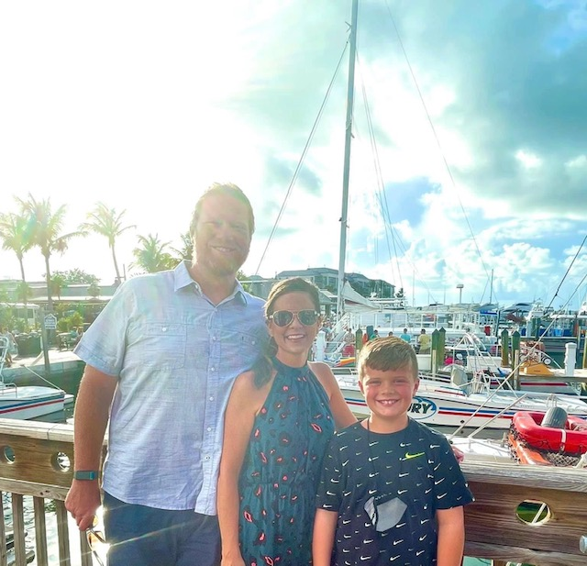
ABOUT ME
I am Candace Baum, and I am thrilled to be a teacher here at JCHS! When I'm not grading essays, I'm hanging out with my son (Asher), my husband (Michael), and our dog and cat (Scout and Leo). I enjoy traveling, going to concerts, reading, baking, and watching my son play baseball.
University of North Alabama M.A. in English (2002)
University of North Alabama B.S. in Secondary Education (2000)

Slide 3
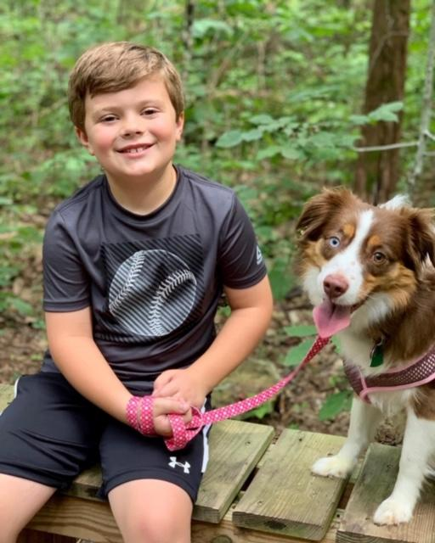
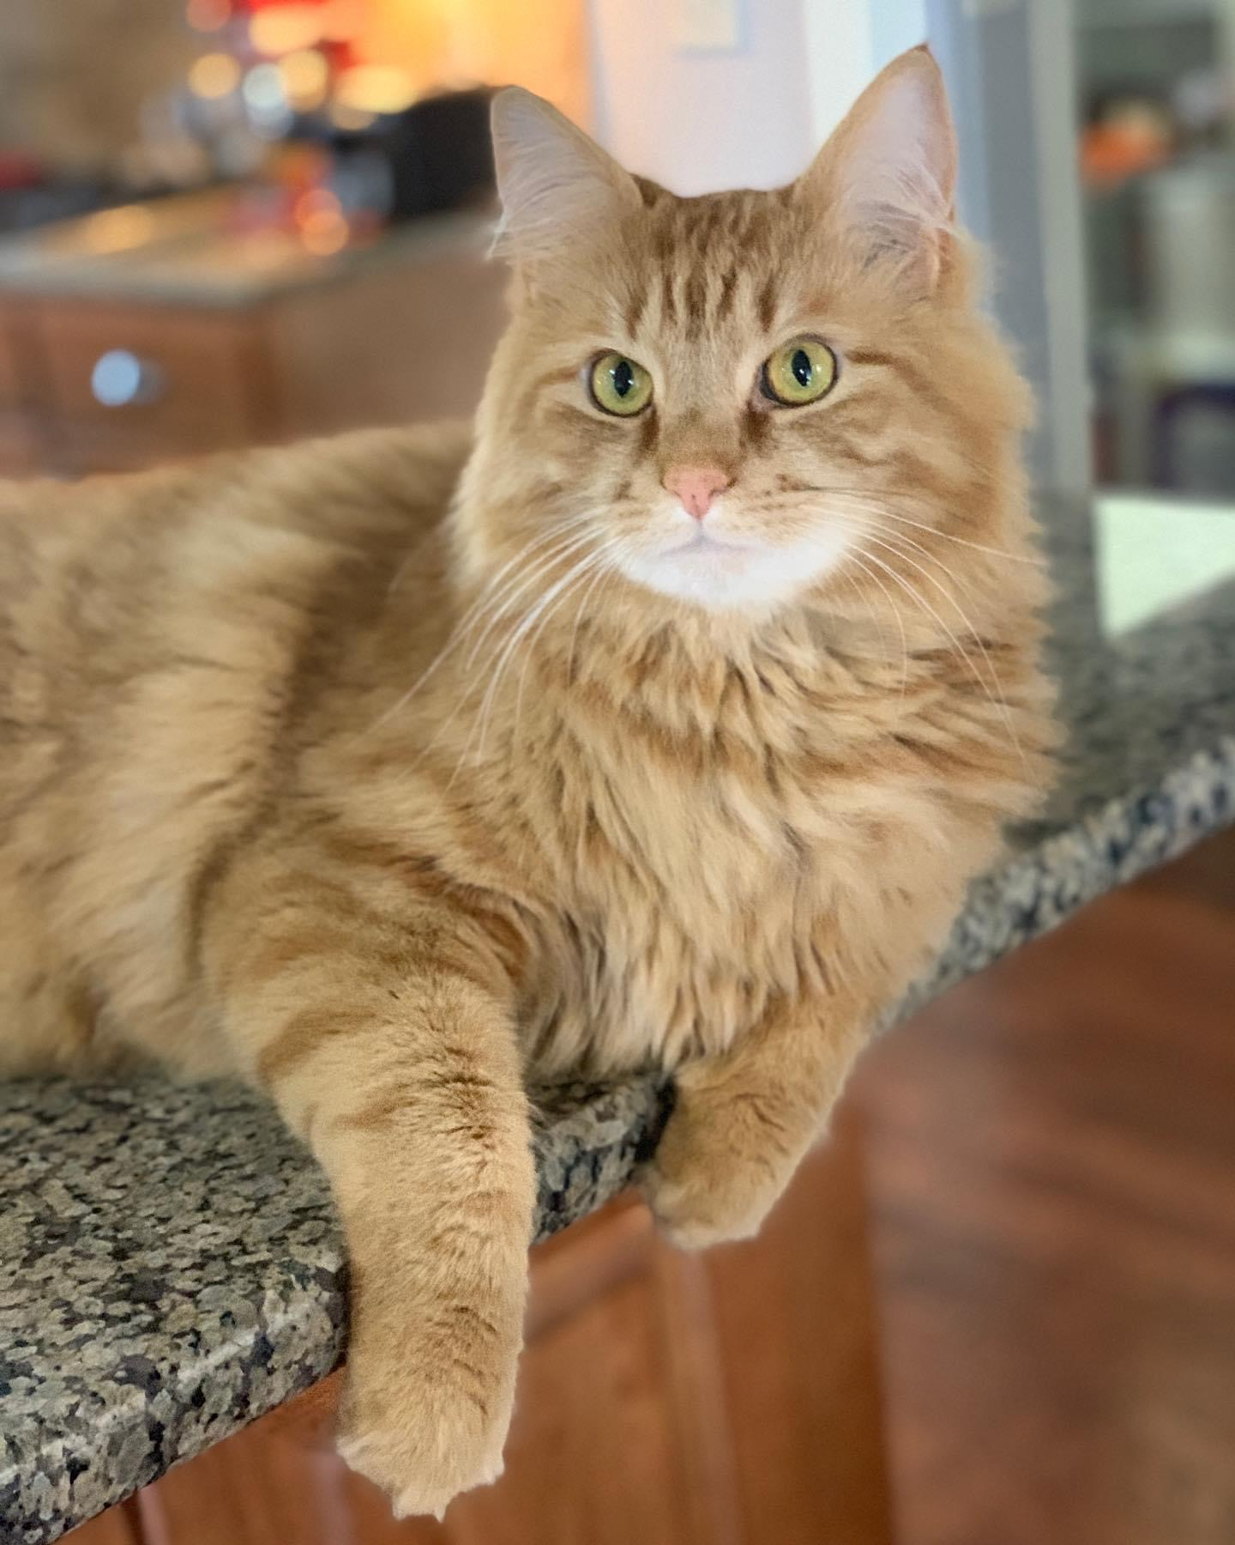
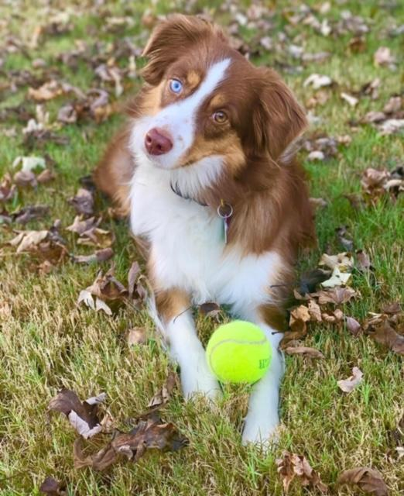

Slide 4
SCHEDULE
FALL | SPRING
AP Language and Composition | AP Language and Composition
Pre-AP English 10 | Pre-AP English 10
Pre-AP English 10 | Pre-AP English 10
Planning | Planning

Slide 5
CONTACT INFORMATION
EMAIL: cgbaum@madisoncity.k12.al.us
WEBEX:
https://madisoncity.webex.com/meet/cgbaum
PHONE: 256-216-5313

Slide 6
